Slide 1

Team Details
Team name: Binerd
Team leader name: Owen Prathama
Problem Statement:

Slide 2
Problem Statement 1: Optimizing Retail Inventory with Multi Agents
Challenge Overview:
In the rapidly evolving retail industry, maintaining an optimal balance between product availability and inventory costs is a key challenge. Retail chains often face issues of stockouts (running out of popular items) or overstocking (leading to higher holding costs). To address these challenges, we invite you to design a multi-agent Al system that collaborates between stores, warehouses, suppliers, and customers to optimize inventory management.
The goal is to create a multi-agent Al system that can predict demand, ensure product availability, reduce inventory holding costs, and improve supply chain efficiency. Your solution should enable seamless collaboration among different agents to manage inventory proactively, avoid stockouts, and minimize the excess holding of inventory, thereby maximizing sales and improving operational efficiency.
Current process:
﻿﻿Demand Forecasting: Retail managers review historical sales data, market trends, and seasonal patterns. Manual calculations or basic forecasting models are used to estimate future demand for various products. These estimates are shared with warehouses and stores to prepare for anticipated demand.
﻿﻿Inventory Monitoring: Retail managers regularly perform physical stock checks at stores and warehouses. Inventory records are manually updated in the system to reflect stock levels. Discrepancies between actual stock levels and the recorded inventory are investigated manually, often requiring manual audits.
﻿﻿Pricing Optimization: Retail managers analyze stock levels and manually adjust prices on slow-moving inventory to encourage sales. Price changes are communicated to all stores and online platforms. Sales trends and customer feedback are periodically analyzed to assess the impact of pricing changes.
Expected Technical Output: Multiagent framework

Slide 3
Brief about your Solution
Our solution is an AI multi-agent system designed to optimize inventory management in the retail industry. The system will use AI technology to predict demand, manage inventory, and optimize product pricing. Using a multi-agent framework, our system will enable collaboration between stores, warehouses, suppliers, and customers to optimize inventory and reduce carrying costs.

Slide 4
Opportunities •⁠ ⁠a. How different is it from any of the other existing ideas?
Our solution is different from other solutions because it uses AI multi-agent technology that allows collaboration between various entities in the supply chain. In addition, our solution also uses Gemini API to enhance prediction and optimization capabilities.
•⁠ ⁠b. How will it be able to solve the problem?
Our solution can solve inventory management problems in the retail industry by accurately predicting demand, effectively managing inventory, and optimizing product pricing. Thus, our solution can reduce carrying costs, increase sales, and improve operational efficiency.
•⁠ ⁠c. USP of the proposed solution
The USP (Unique Selling Point) of our solution is the ability to optimize inventory management in real-time using AI multi-agent technology and Gemini API. In addition, our solution can also improve collaboration between various entities in the supply chain, thereby increasing efficiency and reducing costs.

Slide 5
List of features offered by the solution
•⁠ ⁠Accurate demand prediction using AI technology
•⁠ ⁠Effective inventory management using a multi-agent framework
•⁠ ⁠Real-time product price optimization
•⁠ ⁠Collaboration between stores, warehouses, suppliers, and customers
•⁠ ⁠Analysis of sales data and customer feedback
•⁠ ⁠Integration with Gemini API to enhance prediction and optimization capabilities

Slide 6
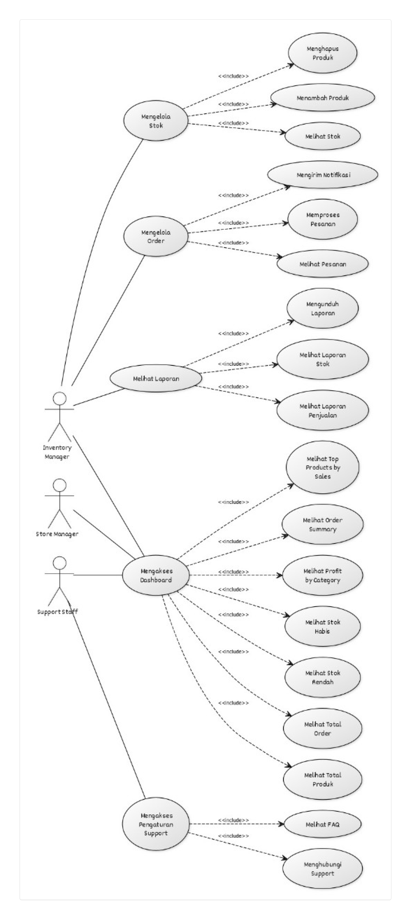
Process flow diagram or Use-case diagram
Link : https://yuml.me/owenpi28/preview/usecaseBINERDMART

Slide 7
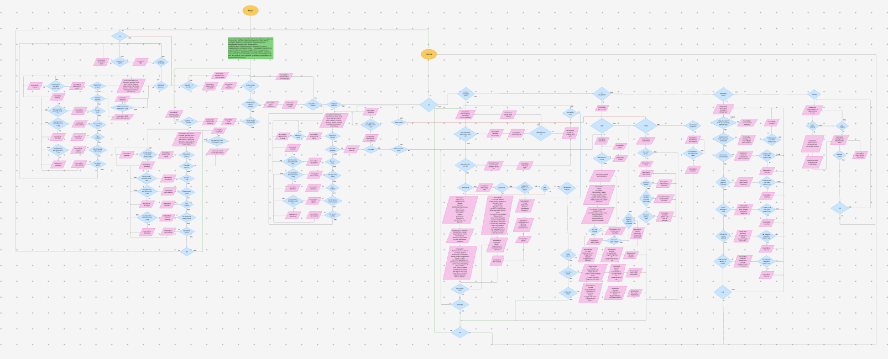
Wireframes/Mock diagrams of the proposed solution Link: https://www.figma.com/board/ThxoSHuqLmqHG6B7OfG6Hc/Untitled?node-id=0-1&p=f&t=B0ZAm2xXGLflbFqe-0

Slide 8
Technologies to be used in the solution (Mandatory to integrate Gemini APIs)
•⁠ ⁠AI multi-agent framework (e.g. JADE, Repast)
•⁠ ⁠AI technologies for demand prediction and price optimization (e.g. machine learning, deep learning)
•⁠ ⁠Gemini API to enhance prediction and optimization capabilities
•⁠ ⁠Python or Java programming language for solution development
•⁠ ⁠Database to store sales and inventory data (e.g. MySQL, MongoDB)

Slide 9
Estimated implementation cost (optional)
Kategori | Komponen | Rincian | Estimasi Biaya
1. Pengembangan Aplikasi | Tim Pengembang | 1 PM, 2 Backend, 1 Frontend, 1 ML Engineer, 1 UI/UX | Rp 150 – 250 juta
 | Desain UI/UX | Mockup, wireframe, user testing | Rp 10 – 20 juta
 | Integrasi Gemini API & Multi-Agent System | JADE/Repast + API Implementation | Rp 20 – 40 juta
 | Testing & QA | Manual + automated testing | Rp 10 – 15 juta
 | Subtotal |  | Rp 190 – 325 juta
2. Infrastruktur & Teknologi | Server & Database Cloud | AWS/GCP, MySQL/MongoDB | Rp 5 – 10 juta / bulan
 | Gemini API | Estimasi kueri & pemakaian API | Rp 2 – 5 juta / bulan
 | ML Pipeline & Storage | Model training & deployment | Rp 3 – 7 juta / bulan
 | Domain & SSL | Domain + sertifikat keamanan | Rp 500 ribu – 1 juta / th
 | Subtotal (6 bulan) |  | Rp 60 – 120 juta
3. Operasional & Training | Support & Maintenance | 1 DevOps + 1 Support Engineer | Rp 10 – 20 juta / bulan
 | Pelatihan Pengguna | Materi training admin/gudang/toko | Rp 5 – 10 juta
 | Promosi Awal / Go-to-Market | Sosial media, kampanye distributor | Rp 10 – 25 juta
 | Subtotal (6 bulan) |  | Rp 80 – 150 juta
TOTAL BIAYA 6 BULAN |  |  | Rp 330 – 595 juta

Slide 10
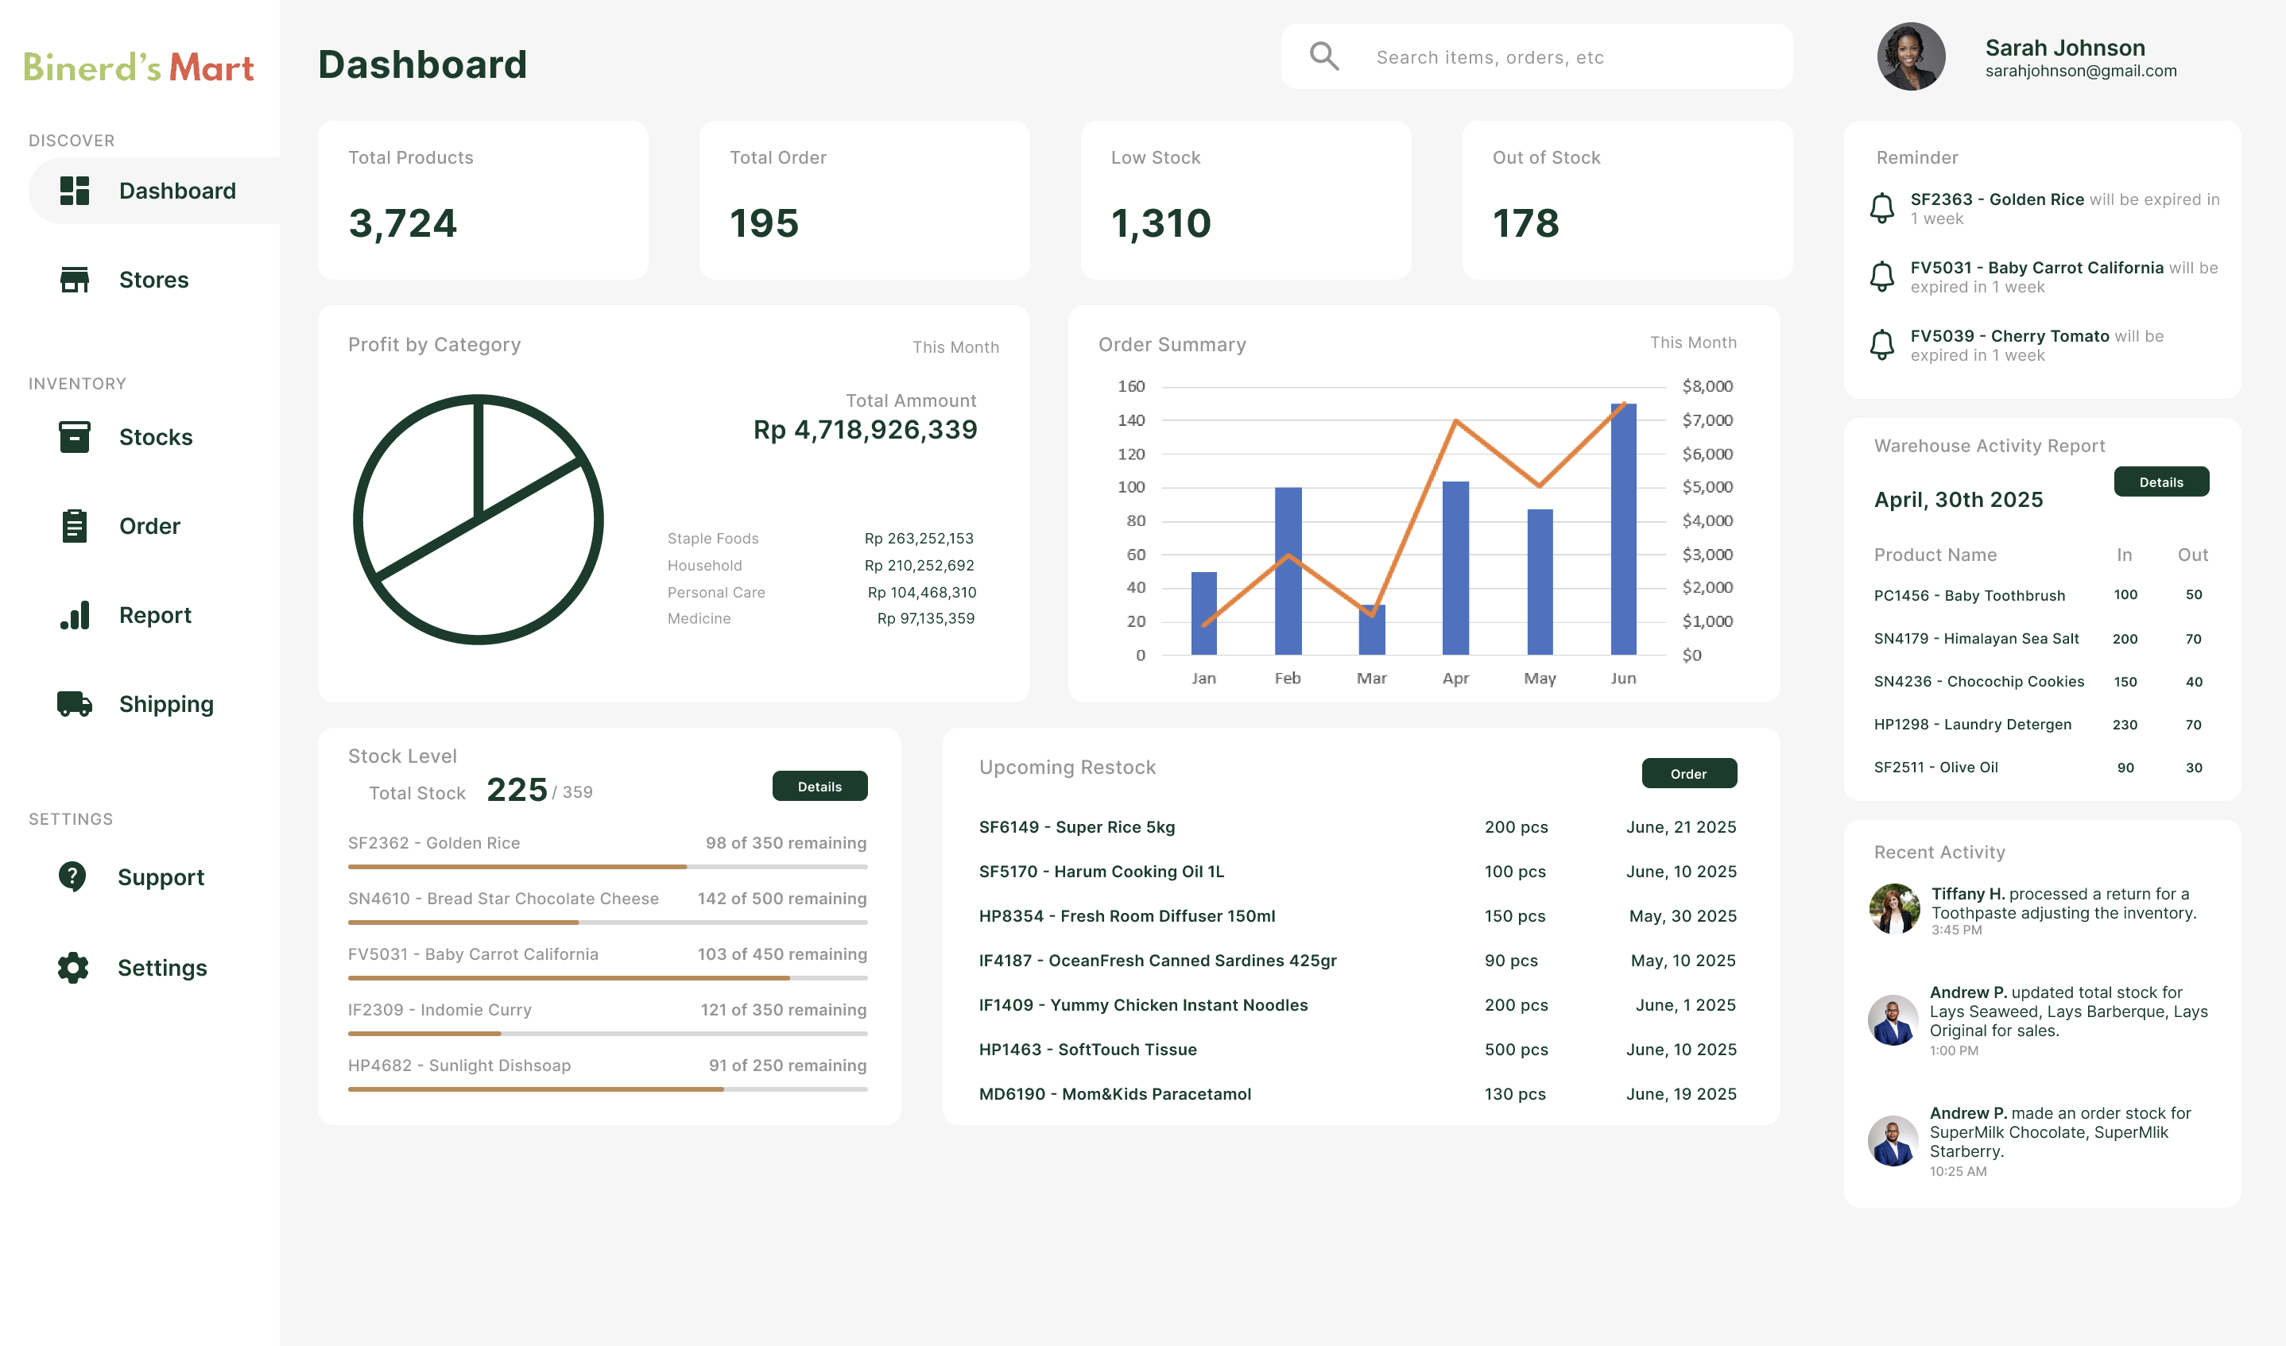
Snapshots of the prototype

Slide 11
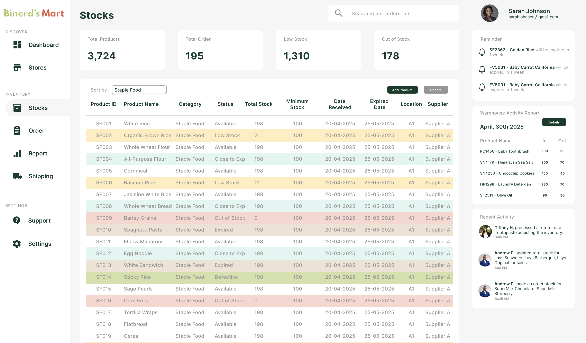
Snapshots of the prototype

Slide 12
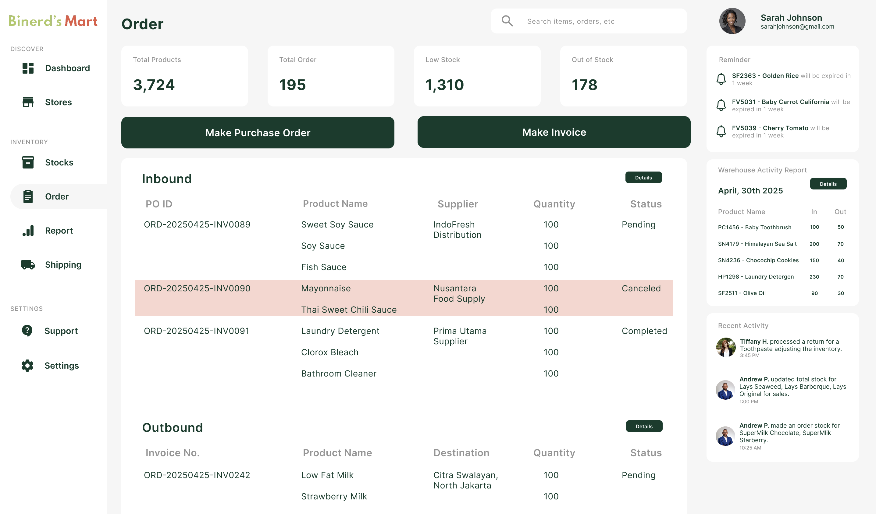
Snapshots of the prototype

Slide 13
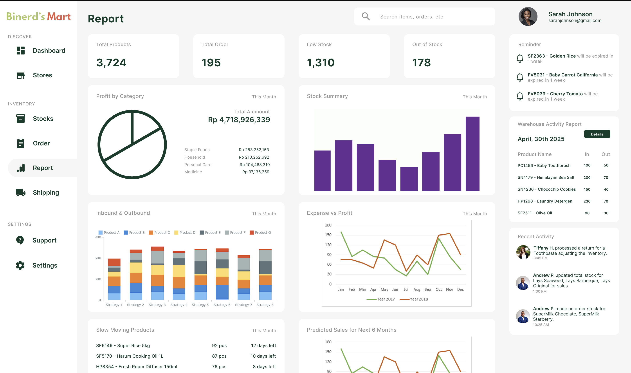
Snapshots of the prototype

Slide 14
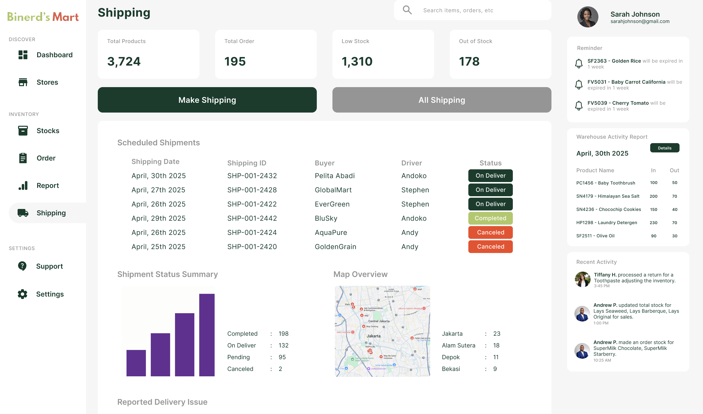
Snapshots of the prototype

Slide 15
Provide links to your:
Demo video link (3 minutes) : https://drive.google.com/file/d/1wqe7Wh_h8XvoybRu28LZxCzFZN-iE4yr/view?usp=share_link
Working prototype link : https://www.figma.com/design/9WI1I6LMi8sSNVf6u5UPeG/BINERD-S-MART?node-id=0-1&p=f&t=5QH3wk8qH3YbonGs-0

Slide 16
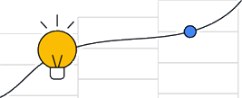




Solution Challenge
Google Developer Gror‹ps

